Slide 1
PyFluent + Dash + PPTX Report Generator
Ryan O’Connor
Lead Application Engineer

Slide 2
Summary
Example – Pipe Elbow Dash App
A web app which allows a user to adjust settings in a Fluent case file and initiate solves, track design point history, and postprocess results by viewing an interactive HTML report or exporting a PowerPoint presentation.
Motivation:
Democratization: Provide a simple web app such that a non-CFD expert can gain insights from Fluent simulations and perform parametric studies without needing any CFD training, local installation of software, or powerful hardware.
Flexible Enhancements: Many customers have requested the ability to export PowerPoint reports from Fluent simulations. With no plans to release such capability, PyFluent offers a simple solution by making use of the open source python-pptx library. Instead of months/years turnaround, PyFluent allowed this solution to be delivered in days.

Slide 3
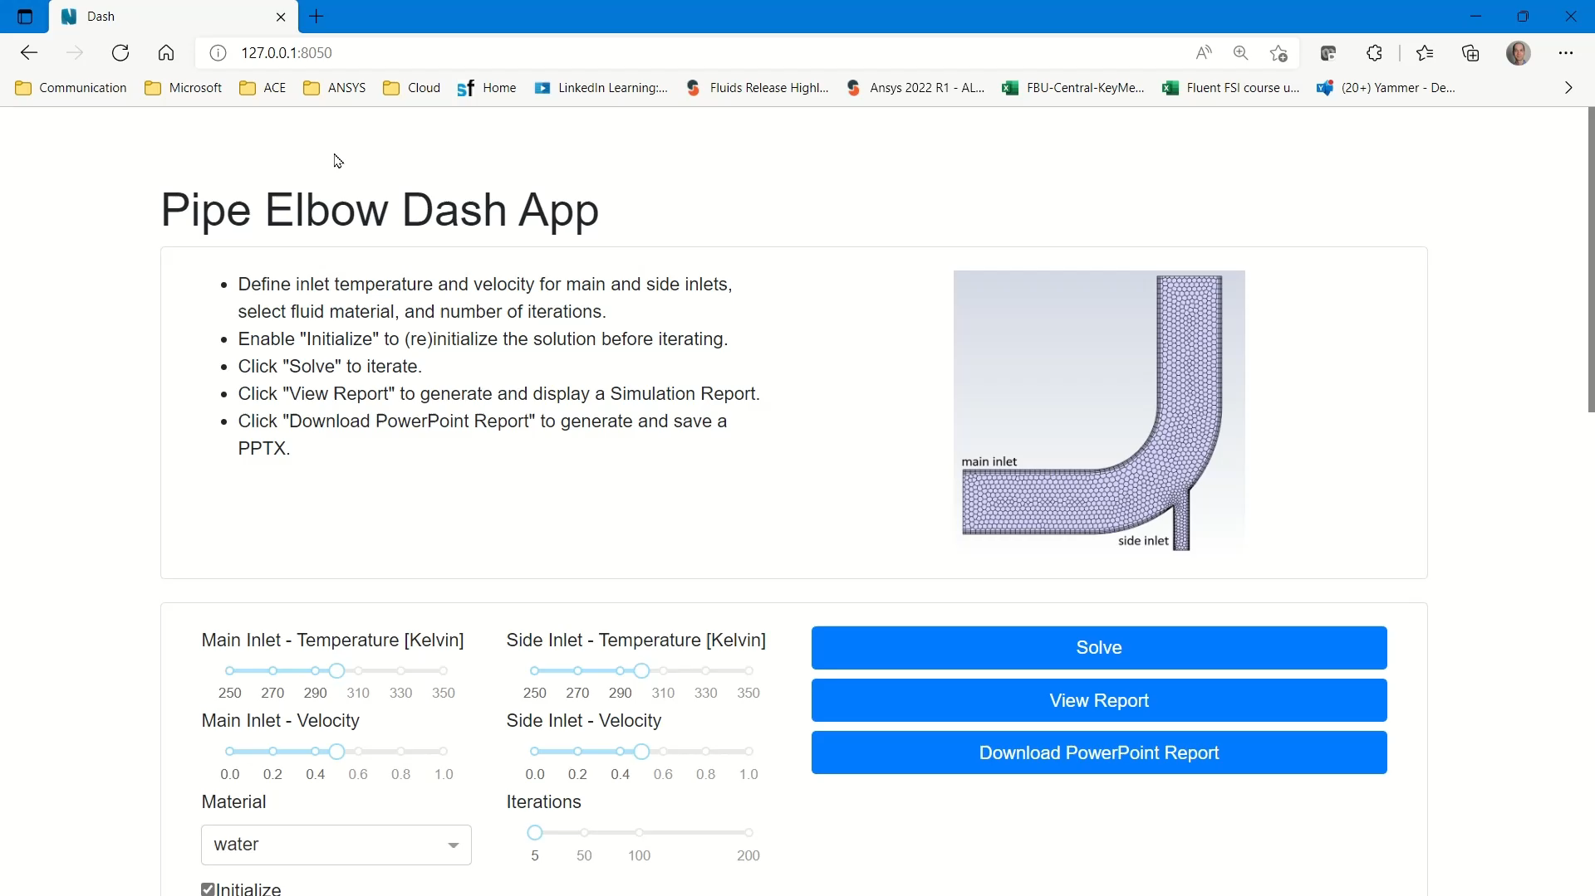
Video Demonstration

